Slide 1
09-18 notes air resistance and simulating motion

Slide 2
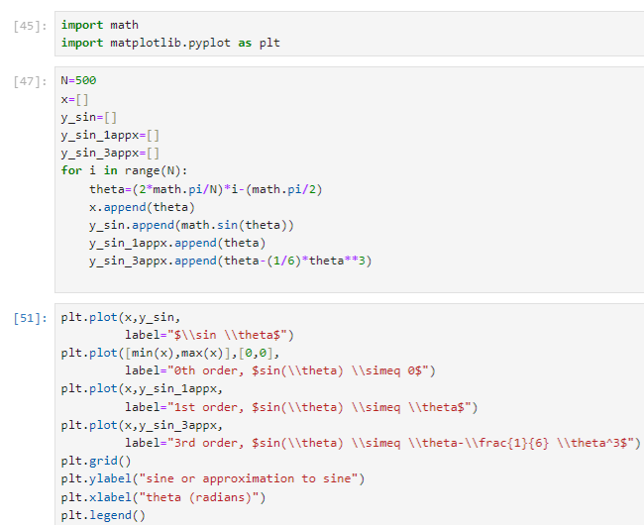

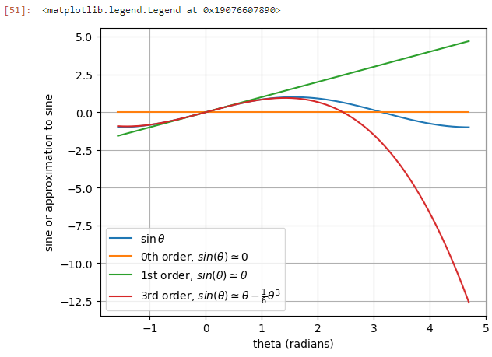
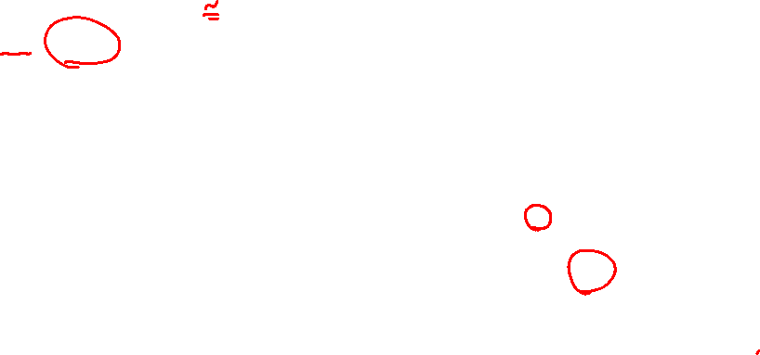
Plotting multiple lines with a legend
LaTeX math formatting

Slide 3
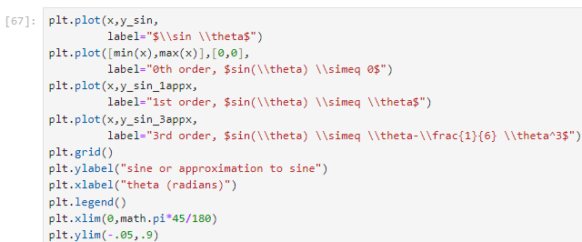
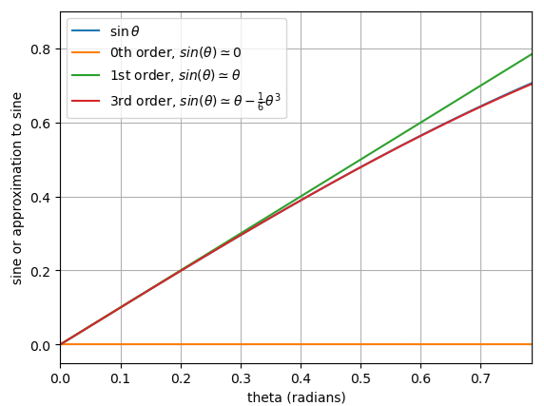

Zooming in with xlim and ylim

Slide 4
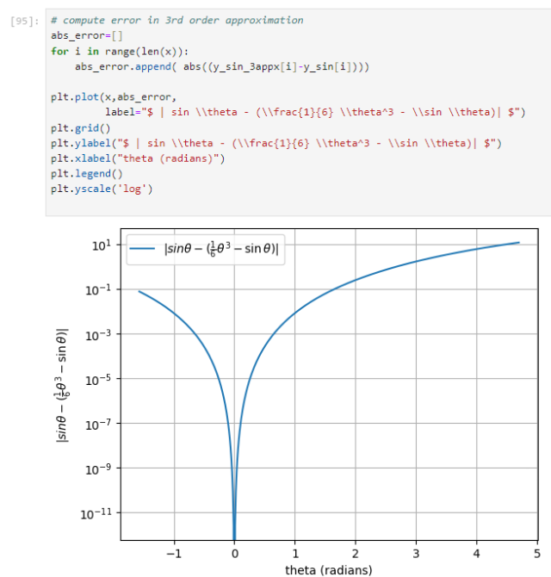
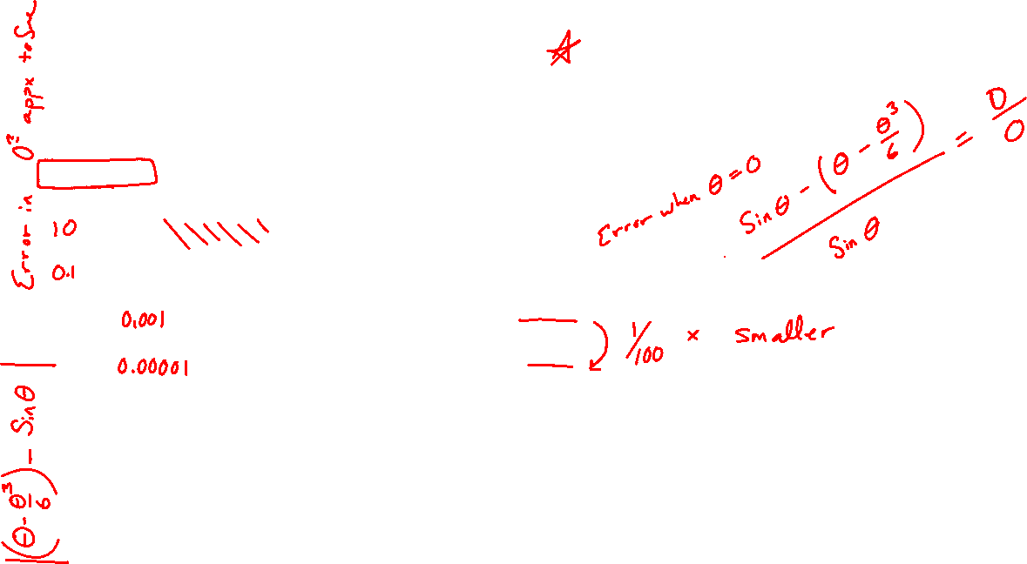
Changing the scale of one axis with yscale()
Note, why does % error calculation fail when plotted this way?

Slide 5
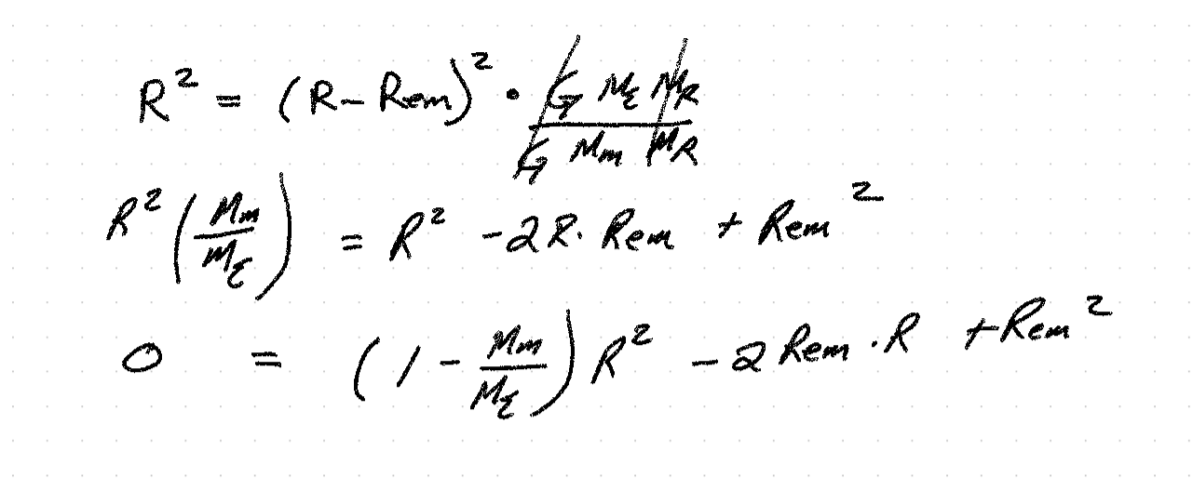











Slide 6













Slide 7
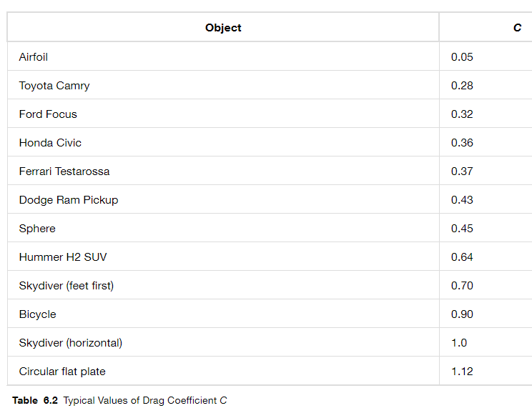











Air resistance model, drop a pumpkin?
https://openstax.org/books/university-physics-volume-1/pages/6-4-drag-force-and-terminal-speed

Slide 8















Slide 9










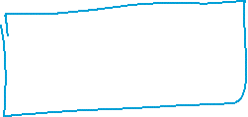





Slide 10
